Slide 1
GORGONICHTHYS-1 · UPPER VULCAN FORMATION (BREWSTER SANDS) · ICHTHYS FIELD, BROWSE BASIN
Hydraulic Flow Units of the 4005–4076 m reservoir
Core–log petrophysics, HFU identification and log-based prediction — what was done, which method won, and why
3
84 %
0.92
27 %
hydraulic flow units
(FZI breaks 1.11 & 2.48 µm)
of flow capacity (kh) from
HFU-3 — only 12 % of thickness
LOO R² of core log k with HFUs
(single φ–k transform: 0.70)
median Sw (Archie, SCAL m 1.86,
n 2.01, Rw 0.0875 Ω·m @148 °C)
Data: suite-3 wireline (AIT/DSI/LDL/CNL, 21-Jul-2000) + CMR · RCA (800 psi NOB) · Core Lab SCAL 2001 (PRP-01029) · Core Lab RCA 2007 (PRP-06145) · MDT (AFL 2000-035)
Processed with the HFA Suite workflow + Python; 24 Sep 2026 · Pratyush
Notes:
Scope: Gorgonichthys-1, reservoir interval 4005–4076 m MD (log depth, drill floor) inside the Upper Vulcan Formation (top 3911.5 m, base 4218 m from Gold_Zones). Earlier Techlog work used 4000–4077 m then 4016–4077 m for core calibration; this study uses the requested 4005–4076 m. Headline: three HFUs; HFU-3 carries ~84% of core flow capacity in ~12% of the thickness. HFU-based permeability explains 92% of log-k variance in leave-one-out tests versus 70% for a single porosity–permeability transform.

Slide 2
02
Data used and the QC decisions that shaped the result
Every exclusion is explicit — nothing removed silently
Dataset | Source / file | Used for
Wireline suite 3 (ft → m) | G1S3_AIT_DSI_NUC_MAINLOG.las | GR, RHOB, NPHI, DRHO, CALI, AT10–AT90, DTCO
CMR (NMR) | G1S3_CMR_1.las | TCMR, T2LM, CMFF (porosity & perm)
Routine core (800 psi NOB) | Core_Data_depth_matched.csv | φ, k_air; report core-to-log shifts
SCAL (Core Lab 2001) | P5285R1A2V1.pdf | a = 1, m = 1.86, n = 2.01, Rw, Pc
RCA (Core Lab 2007) | G31857A3.pdf | grain density; blind k test (8 plugs)
MDT (2000) | MDT LAS + AFL 2000-035 | T = 148 °C; gas samples 4019–4135 m
Zones / reservoir | Gold_Zones.csv, analyst | Upper Vulcan 3911.5–4218 m; 4005–4076 m
Core table: 100 rows → 31 plugs
100 rows = 50 plugs duplicated → de-duplicated. 33 plugs fall in 4005–4076 m. Excluded 2: φ = 1.9 % tight streak (FZI unstable) and k = 63 mD at φ = 7.7 % (probable plug micro-fracture).
Matrix density = 2.65 g/cc
Grain-density column in the core file is a placeholder ("2"). Core Lab 2007 plugs average 2.638 g/cc and the SCAL plugs 2.65–2.66, so ρma = 2.65.
Units confirmed: φ fraction, k_air mD (4 rows with k = 0 lie outside the interval).
All depths are wireline log depth (m MD, drill floor 26.4 m above LAT).
Fluids & conditions
Oil-based mud (MDT reports, OBDT image tool) → shallow, non-conductive invasion, so AT90 ≈ Rt. MDT quartz gauge 148 °C at 4034 m (the LWD 103 °C is circulating). Gas-condensate column.
71 m
466
31
18.5 %
gross interval
log samples (0.15 m)
QC-passed core plugs
bad hole (flagged)
Sources: Core Lab PRP-01029 (SCAL, 2001) pp. 1-2 to 2-8; Core Lab PRP-06145 (RCA, 2007) p. 3-4; Core Lab AFL 2000-035/040 (MDT fluids); Schlumberger LAS headers (21-Jul-2000).
Notes:
Key judgement calls: (1) de-duplicate the core table — duplicated rows would double-weight every plug in the HFU statistics; (2) use suite-3 wireline because it is the dataset your Techlog interpretation used; (3) take ρma from measured grain density rather than the placeholder column; (4) formation temperature from the MDT quartz gauge (148 °C) rather than the LWD circulating temperature (~103 °C) — this matters for Rw.

Slide 3
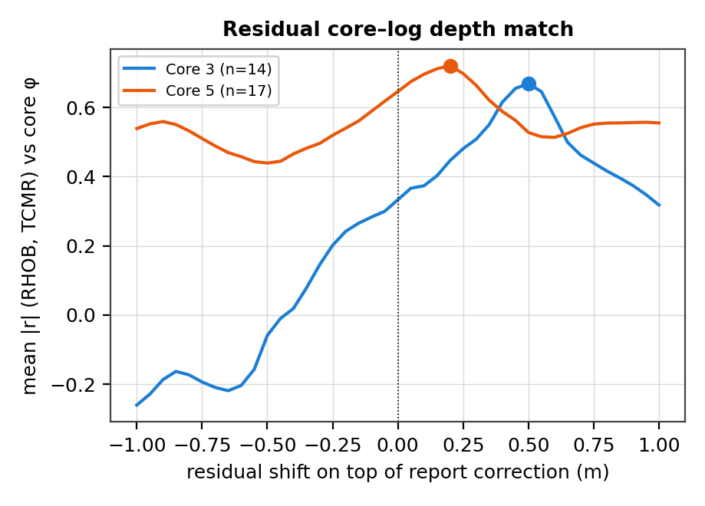
03
Core–log depth match and bad-hole screening
The report shifts (+0.8 to +1.55 m) were a starting point, not the answer
Residual shift tested on top of the report correction
  Correlated core φ with RHOB (inverse) and TCMR over ±1 m, per core
  Core 3: +0.50 m (mean |r| 0.33 → 0.67); Core 5: +0.20 m (0.65 → 0.72); Core 4 (2 plugs): no change
  Plausible: the report shifts were tied to another log run, not suite 3
Bad-hole flag = any of three tests (± one sample)
  CALI − BS > 1 in: 12.0 % of the interval
  |DRHO| > 0.15 g/cc: 1.5 %
  Rugosity / mud signal (RHOB < 2.15 or TCMR > 0.25 with T2LM < 10 ms): 13.7 %
  Total flagged: 18.5 % of 4005–4076 m
Why it matters: in washouts RHOB drops and TCMR reads mud, so PHIT spikes to 0.3–0.5 (as noted in your slide pack). Flagged samples get no φ, Sw, FZI or HFU prediction.
Depth-match metric: mean of −r(RHOB, core φ) and r(TCMR, core φ). Shifted core depth = MD + report correction + residual.
Notes:
Without the residual shift, core porosity vs density correlation in core 3 was only r = −0.19; after +0.5 m it is −0.71. Leaving this uncorrected would have degraded every downstream core–log calibration (porosity, FZI prediction). The shift is small (<1 m) and consistent between RHOB and NMR, which gives confidence it is real.

Slide 4
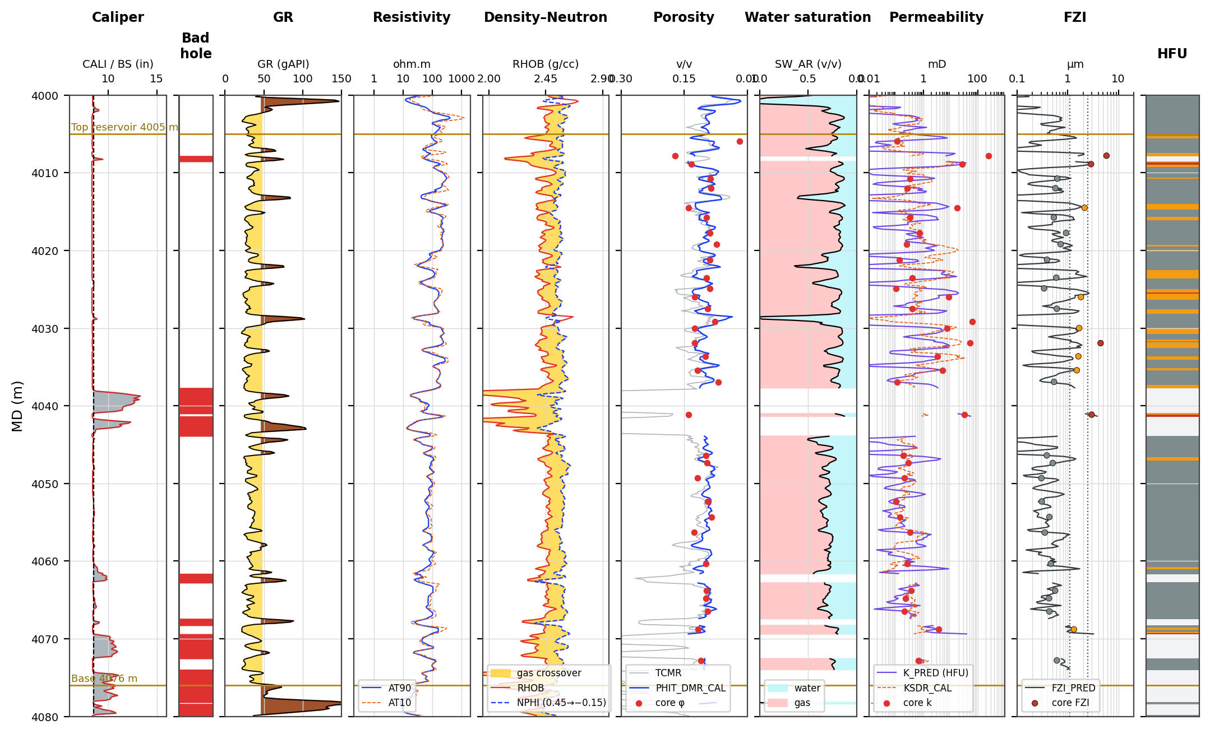
04
Reservoir overview 4000–4080 m: gas-bearing, low-GR, heterogeneous
Tan band = reservoir 4005–4076 m; right-hand track = predicted HFU (hatched = bad hole, no prediction)
What the logs say
Clean sands: GR ~ 32 gAPI.
Strong density–neutron crossover throughout (gas).
AT90 ≈ 85 Ω·m, and AT10 tracks AT90 (OBM).
Core k spans 0.1–255 mD at similar φ — pore geometry, not porosity, controls flow.
HFU pattern
HFU-3 (red) and HFU-2 (amber) occur as thin beds in the upper half (4007–4041 m).
4045–4066 m is dominated by HFU-1 (tight).
The lower interval is interrupted by washouts.
Tracks: CALI/BS · bad-hole flag · GR · AT90/AT10 · RHOB/NPHI · TCMR & PHIT_DMR_CAL + core φ · SW_AR · K_PRED, KSDR_CAL + core k · FZI_PRED + core FZI · HFU_PRED.
Notes:
Display is the conventional Techlog-style layout. Core points are at shifted depth. Note the thin high-FZI beds: many are thinner than the ~0.6 m vertical resolution of density/NMR logs, which is why log-predicted FZI underestimates the highest unit.

Slide 5
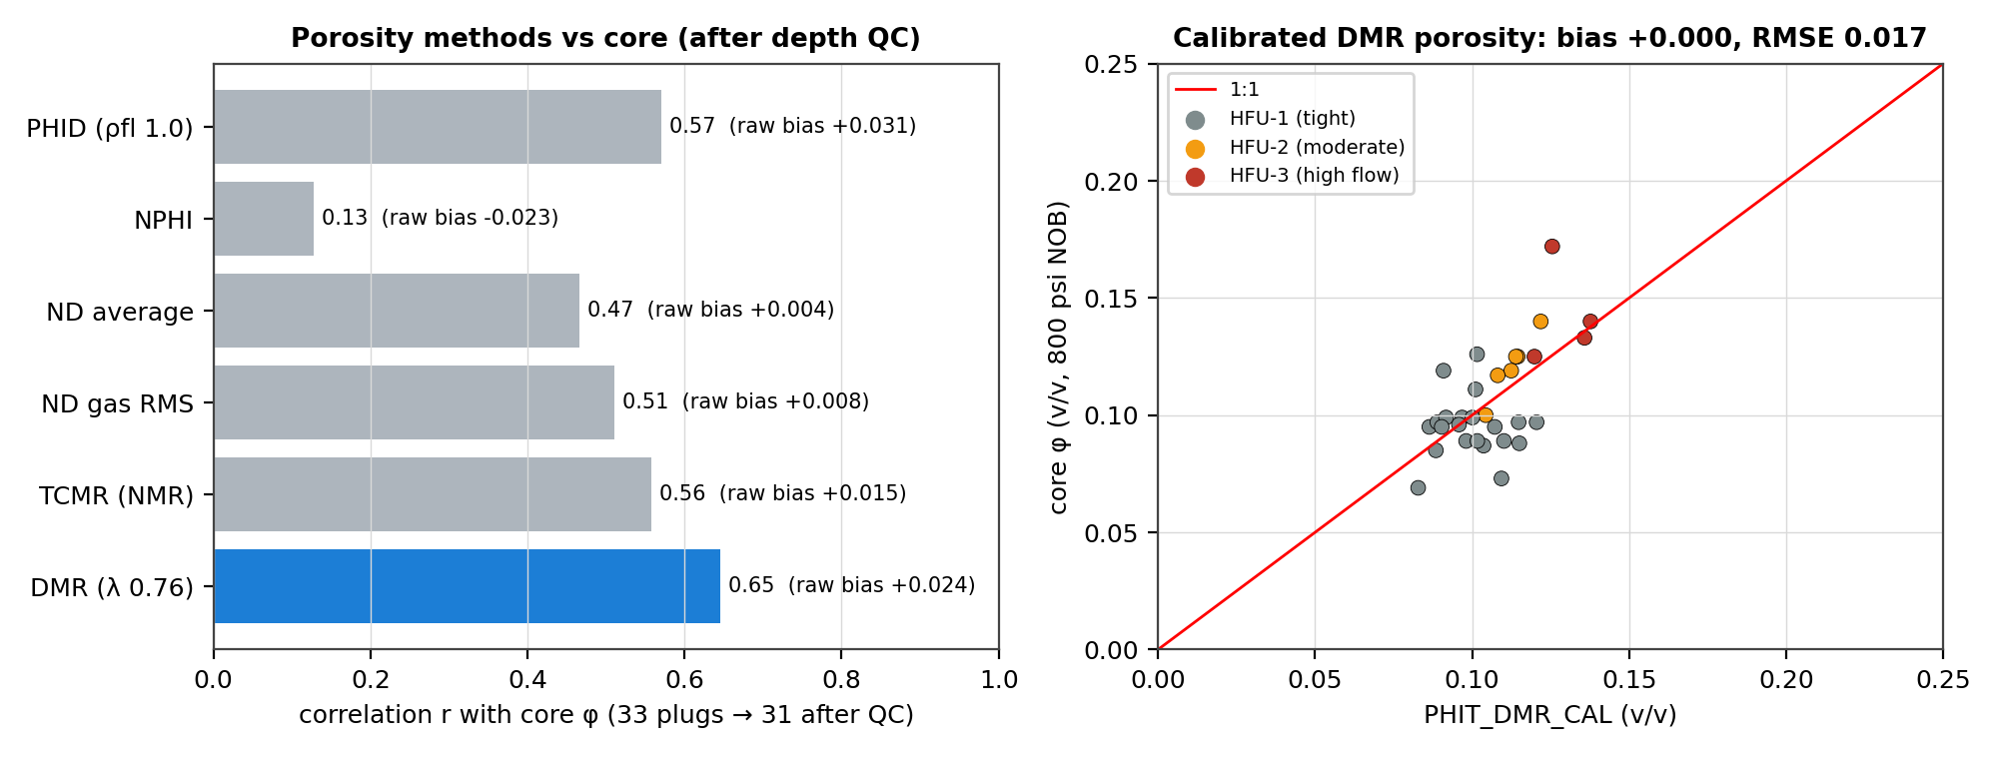
05
Porosity: density–magnetic resonance (DMR) calibrated to core
Six candidate methods tested against 31 core plugs after the depth fix
Why not plain ND?
  Gas lowers RHOB (PHID reads high) and lowers NPHI (reads low); the RMS gas formula only partly compensates
  NMR under-reads in gas (low hydrogen index), so TCMR alone is biased
DMR (Freedman et al., 1998) combines both
  φ_DMR = (PHID + λ·TCMR)/(1+λ), λ = [(ρf − ρg)/(ρma − ρf)]/(1 − HI_g·P_g) ≈ 0.76
  Highest correlation with core (r 0.65) and lowest leave-one-out error after calibration
Final: PHIT = 0.0154 + 0.705·φ_DMR (bias 0.000, RMSE 0.017)
Method | raw bias | r | LOO-cal. RMSE
PHID (ρfl 1.0) | +0.031 | 0.57 | 0.0230
ND gas RMS (Techlog default) | +0.008 | 0.51 | 0.0240
TCMR (NMR) | +0.015 | 0.56 | 0.0231
DMR (λ 0.76) — selected | +0.024 | 0.65 | 0.0214
Core φ at 800 psi NOB (not overburden-corrected; expect ≤ 0.005 v/v reduction in situ). Plug-to-log scale mismatch caps achievable r (core φ SD is only 0.026).
Notes:
Honest caveat: all methods have RMSE close to the core-porosity standard deviation (0.026) because plugs sample 2.5 cm while logs average ~0.6 m, and many beds are thinner than log resolution. DMR is chosen because it is physically designed for gas with OBM, has the best correlation, and the best cross-validated error; the ND gas formula is the best uncalibrated option if NMR is not available in other wells.

Slide 6
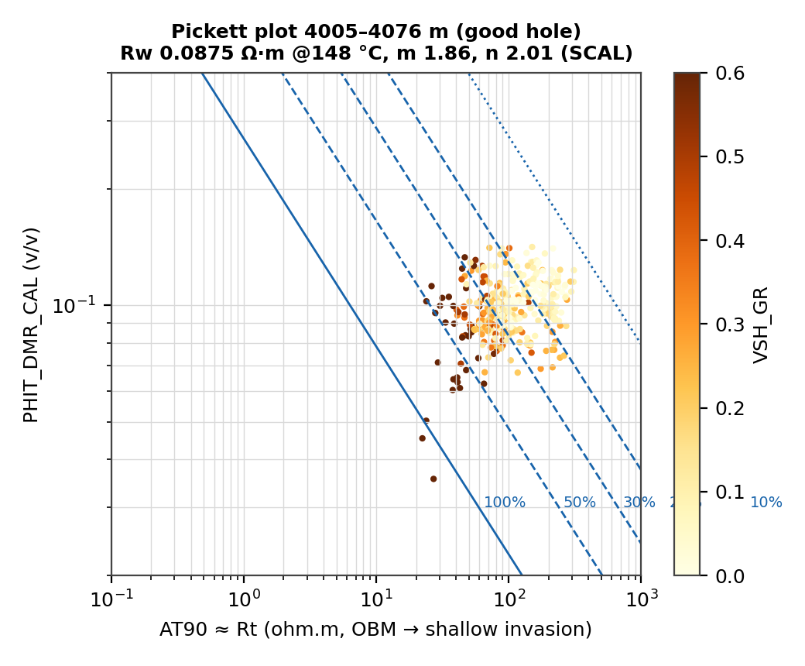
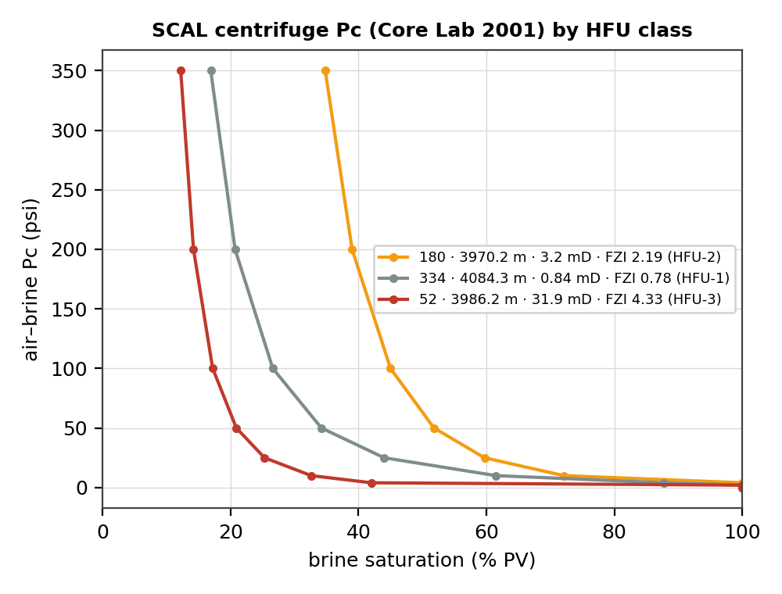
06
Water saturation: Archie with SCAL m, n and brine Rw
The interval has no water leg, so a Pickett water line cannot be picked in-zone
Parameter | Value | Basis
a, m | 1.0, 1.86 | SCAL FRF, 4100 psi
n | 2.01 | SCAL RI (avg)
Rw @ 25 °C | 0.319 Ω·m | 20,000 ppm brine
T formation | 148 °C | MDT gauge 4034 m
Rw @ T | 0.0875 Ω·m | Arps
Rt | AT90 | OBM, minor invasion
Rwa P10 = 0.58 Ω·m ≫ Rw 0.0875: every good-hole point plots in hydrocarbon (gas confirmed by MDT at 4019–4135 m). Rw therefore comes from the SCAL brine, not the plot.
Result: Sw P50 27 % (P10–P90 16–38 %); HFU-1 28 %, HFU-2 18 %, HFU-3 15 %.
Check: centrifuge Swi at 350 psi = 12–43 % — same range. The HFU-3 plug holds the least water (12 %).
Using the Techlog defaults (m = n = 2, Rw 0.05) would give Sw ≈ 20 % — optimistic by ~7 s.u.
Arps: Rw(T2) = Rw(T1)·(T1 + 21.5)/(T2 + 21.5), °C. Pc plugs are outside 4005–4076 m (3970–4084 m) and are assigned an HFU by FZI.
Notes:
SCAL notes a tentative link of lower m with higher permeability; with only five FRF plugs a single m = 1.86 is used. The HFU-1 Pc plug (4084 m) holding less water than the HFU-2 plug shows the Pc–HFU link is only partly supported by four plugs — recommend Pc per HFU in future SCAL.

Slide 7
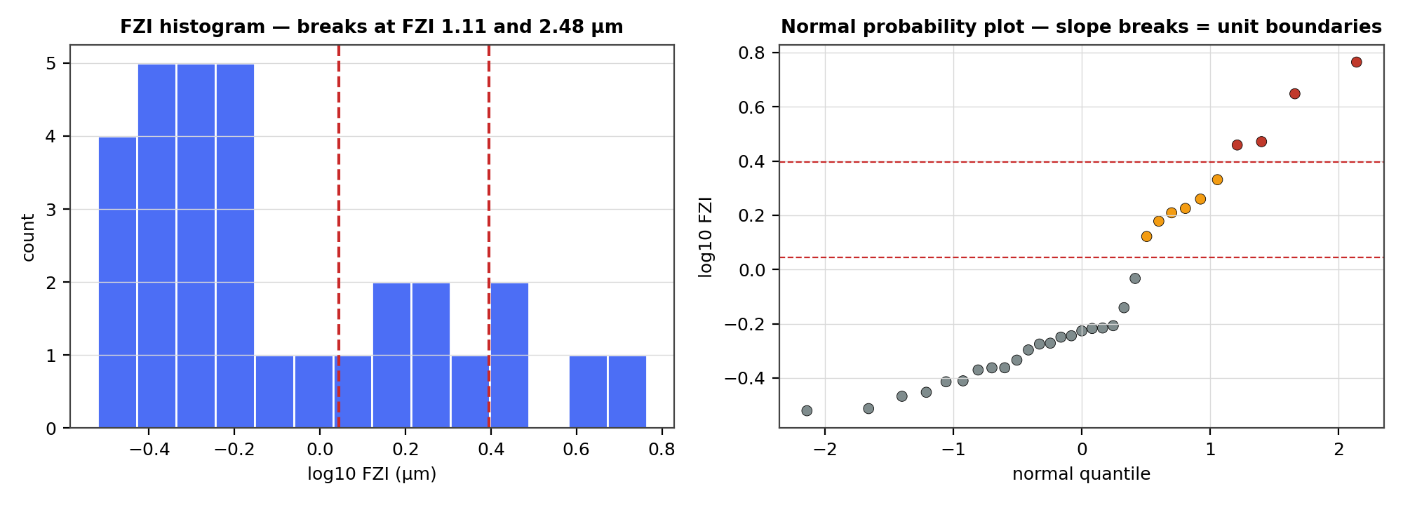
07
HFU identification: three units defined by stable FZI breaks
FZI = RQI/φz, with RQI = 0.0314·√(k/φ) and φz = φ/(1−φ) (Amaefule et al., 1993)
Why 3 units, and why these breaks
  Statistics (BIC) support at least two populations; 1.11 µm is the strongest break
  2.48 µm recurs in the K = 3 and K = 4 Jenks solutions → stable, not an artefact
  0.48 µm splits two groups that both sit below 1 mD (k_air, no Klinkenberg correction) — no practical difference in flow
  K ≥ 4 leaves units with 2–4 plugs → over-fits 31 samples
DRT (2 ln FZI + 10.6) gives 7 classes (8–14): too many for this data; used as a cross-check only
Result: HFU-1 < 1.11 µm ≤ HFU-2 < 2.48 µm ≤ HFU-3
Test (31 plugs) | K = 2 | K = 3 | K = 4 | K = 5
GMM BIC (lower = better; K1 = 30.3) | 22.1 | 28.9 | 30.9 | 40.3
Jenks goodness of variance fit | 0.81 | 0.90 | 0.95 | 0.97
Plugs per unit | 21/10 | 21/6/4 * | 10/11/6/4 | 10/11/5/3/2
Break recurs at K = 2, 3, 4? | 1.11 | 1.11, 2.48 * | +0.48 | +3.6
* selected scheme
HFU-1
FZI < 1.11 µm · 21 plugs
HFU-2
1.11–2.48 µm · 6 plugs
HFU-3
≥ 2.48 µm · 4 plugs
Jenks = natural breaks on log10 FZI (exhaustive dynamic programming). GMM = Gaussian mixture on log10 FZI. DRT after Guo et al. (2005).
Notes:
Principle: use statistics to propose boundaries and physics/geology plus sample support to decide. The most parsimonious scheme that separates practically different flow behaviour is kept. Earlier app runs gave 0.484/1.09/3.53 µm (four units) — the extra 0.48 µm break is dropped for the reasons stated.

Slide 8
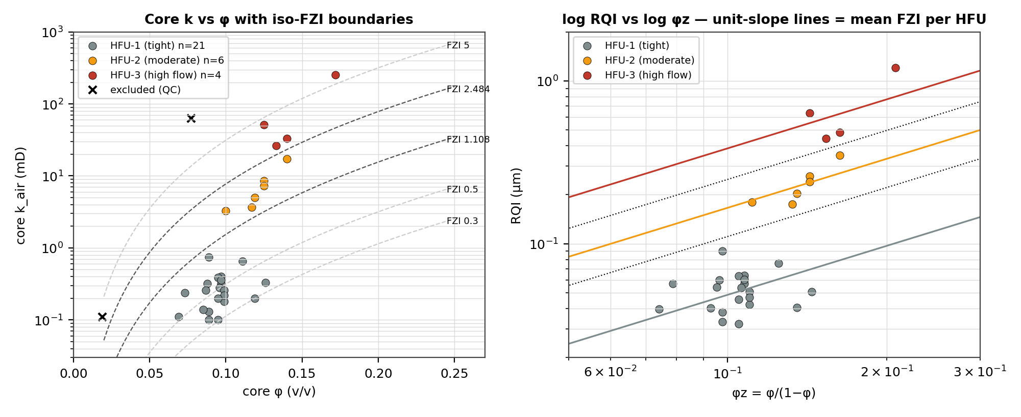
08
HFU characterisation: one φ–k law per unit
Each unit follows its own unit-slope RQI–φz line; k = 1014·FZI²·φ³/(1−φ)²
Permeability skill (core domain)
Single φ–k transform: R² 0.74 (LOO 0.70).
HFU transforms: R² 0.94 (LOO 0.92).
Unexplained variance is ~4× smaller.
Geological reading
GR is similar across units (25–30 gAPI), so clay does not separate them — grain size, sorting and cement do. This matches Core Lab's SCAL conclusion: quality is "controlled by grain-size (pore-throat) distribution rather than clay".
HFU | n | φ mean (range) | k geomean (range), mD | FZI µm | k equation (mD)
HFU-1 tight | 21 | 0.095 (0.069–0.126) | 0.24 (0.10–0.74) | 0.49 | k = 239·φ³/(1−φ)²
HFU-2 moderate | 6 | 0.121 (0.100–0.140) | 6.3 (3.3–17) | 1.66 | k = 2 804·φ³/(1−φ)²
HFU-3 high flow | 4 | 0.143 (0.125–0.172) | 58 (26–255) | 3.85 | k = 15 064·φ³/(1−φ)²
Capillary-pressure link (SCAL)
The HFU-3 plug (FZI 4.3 µm) drains to 12 % Sw at 350 psi; the HFU-1 and HFU-2 plugs hold 17–35 %. Four plugs only, and all outside the interval.
LOO = leave-one-out: unit mean FZI recomputed without the tested plug. k_air at 800 psi NOB. Core Lab PRP-01029 p. 1-2.
Notes:
The HFU-3 unit has only four plugs; its mean FZI (3.85 µm) is the least certain. HFU-1 includes the whole sub-1 mD population; the RQI–φz slope inside HFU-1 is flatter than 1 because the porosity range is narrow — expected for a tight unit.

Slide 9
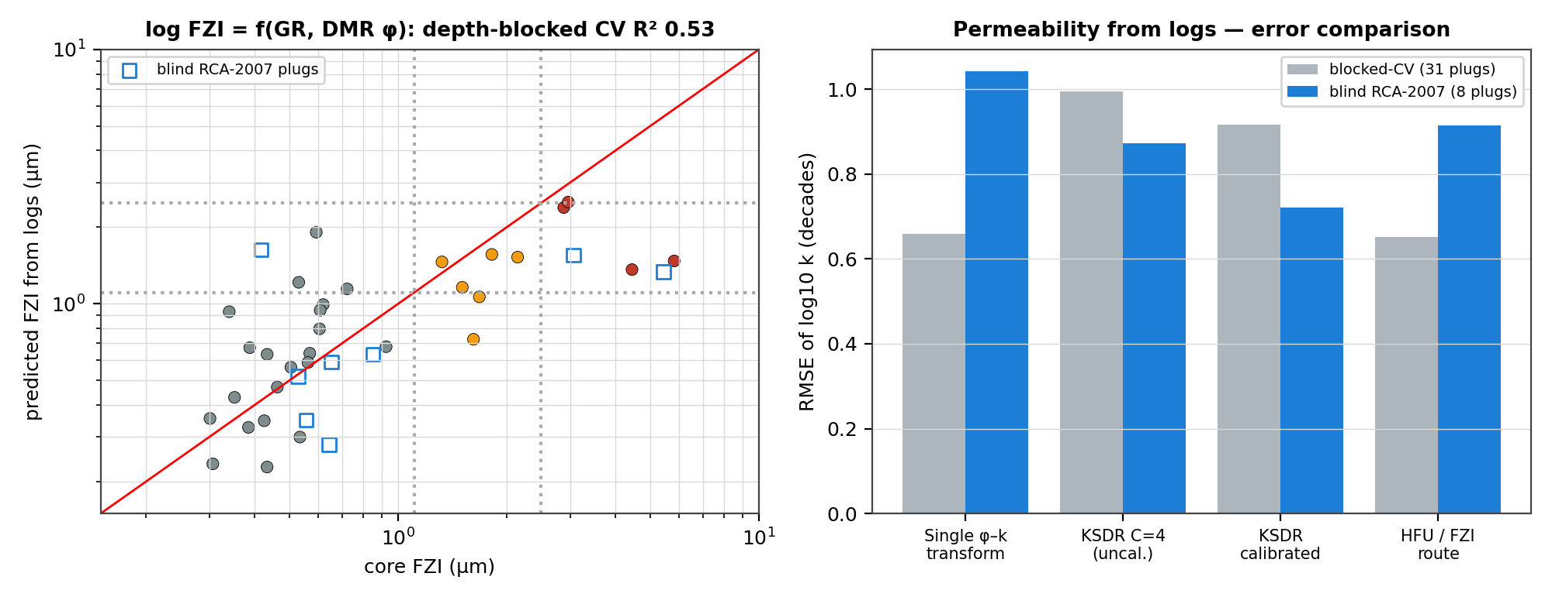
09
Extending HFUs to the logged interval
log10 FZI = −0.932 − 0.0244·GR + 11.93·φ_DMR — chosen for physics and depth-blocked skill, not in-sample fit
Why this model
FZI rises with porosity (better sorting and less cement) and falls with clay (GR).
Resistivity and T2 are fluid- and OBM-affected in gas, and they degraded blocked-CV skill.
A 7-input random forest over-fits 31 plugs.
FZI model (31 plugs, 5 depth blocks) | CV R²
GR + φ_DMR (selected: 2 physical inputs) | 0.53
GR, RHOB, NPHI, DTCO (MLR) | 0.35
Random forest (7 logs) | 0.24
NMR T2LM only | −0.32
Blind test: 8 RCA-2007 plugs (never used in training)
  HFU class exact 5/8, within one class 8/8
  k error 0.91 decades (HFU route) vs 0.72 (calibrated KSDR) vs 1.04 (single φ–k)
Honest limitation
  Logs smooth thin high-FZI beds: HFU-3 is 13 % of core plugs but only 2 % of log samples
  On logs the HFU route ties the single transform (CV 0.65 vs 0.66 decades)
  Use HFU_PRED for zonation and K_PRED with KSDR_CAL as a cross-check
K_PRED = 1014·FZI_PRED²·PHIT³/(1−PHIT)². KSDR_CAL = C·T2LM²·TCMR⁴ with C fitted to core. The RCA-2007 plugs are at 400 psi confining (ambient) and use the same core-to-log shifts.
Notes:
Depth-blocked CV: the 31 plugs sorted by depth split into five contiguous blocks, so neighbouring plugs never sit in both train and test sets. The blind plug at 4071.8 m falls in a washout (bad-hole flag) and is excluded from the blind statistics.

Slide 10
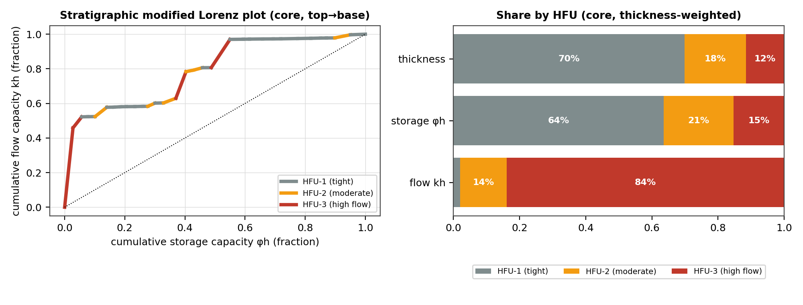
10
Interpretation and recommendations
Flow is concentrated in thin HFU-3 beds — they, not average porosity, control deliverability
Core flow shares are thickness-weighted over the 31 QC-passed plugs; log HFU_PRED fractions (good hole): HFU-1 81 %, HFU-2 17 %, HFU-3 2 %.
Uncertainty: n = 4 plugs in HFU-3; k_air at 800 psi is not Klinkenberg- or stress-corrected; 18.5 % of the interval is bad hole; the four Pc plugs lie outside the interval.
Interpretation
Best-practice choices
Next steps
HFU-3: 12 % of thickness, 15 % of storage, 84 % of kh — the speed zones at ~4008–4009, 4032 and 4041 m.
HFU-1 (70 % of thickness) is storage with little flow and acts as a baffle; its Sw is higher (28 %).
The steep Lorenz curve means a strongly heterogeneous, layered flow profile.
PHIT = core-calibrated DMR (gas + OBM).
Sw = Archie with measured SCAL m, n and Rw at MDT temperature.
HFUs = 3 units from stable Jenks breaks, cross-checked with GMM.
Logs: GR + φ_DMR → FZI, with depth-blocked and blind validation.
Petrography (thin section, XRD, SEM) per HFU to confirm what controls each unit.
Klinkenberg-corrected, stressed k and Pc on HFU-2/3 plugs.
Image log (OBDT) to resolve the thin HFU-3 beds.
Apply the HFU scheme to Dinichthys-1 and Titanichthys-1 cores.
Notes:
References: Amaefule et al. (1993) SPE-26436; Freedman et al. (1998) DMR, SPE-49906; Gunter et al. (1997) SMLP, SPE-38679; Guo et al. (2005) DRT; Core Lab PRP-01029 SCAL (2001); Core Lab PRP-06145 RCA (2007); Core Lab AFL 2000-035/040 MDT fluids; Geoscience Australia Browse Basin petroleum systems (Brewster–Dinichthys–Gorgonichthys–Titanichthys wet-gas/condensate system).

